Slide 1

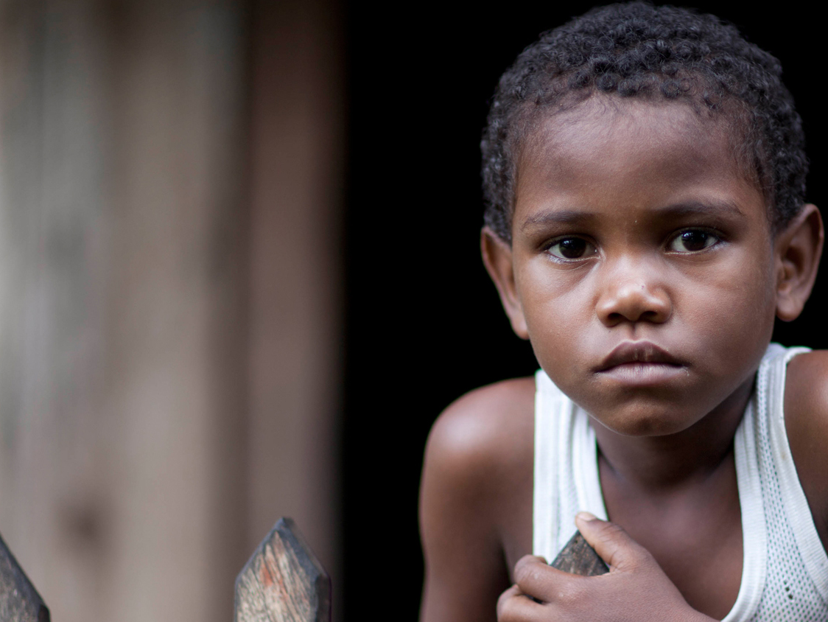
CONTENT SLIDE – Full image
Community Rapid Assessment – Nepal 3rd Round CTF
All Available Visualizations
UNICEF EO ILU

Slide 2
Community Rapid Assessment - Nepal 3rd Round CTF All Available Visualizations
Deliverable Note
This deliverable includes all available visualizations for the third round of the CTF study in Nepal that includes CRA sections.
It is included on this PPT all national distributions of the questions, as well as demographics crossings on Sex, Setting, Education, Age, and Province.
The data purpose is to make available visualizations for the country office to use as necessary on other documents.
This deliverable accompanies a shorter PPT with highlights to note for the round.
To facilitate visualization and printing out of the output from the original script each visualization occupies one slide. If needed, the visualization can be directly modified by request or from the script provided on each delivery.
2
2
UNICEF – for every child

Slide 3
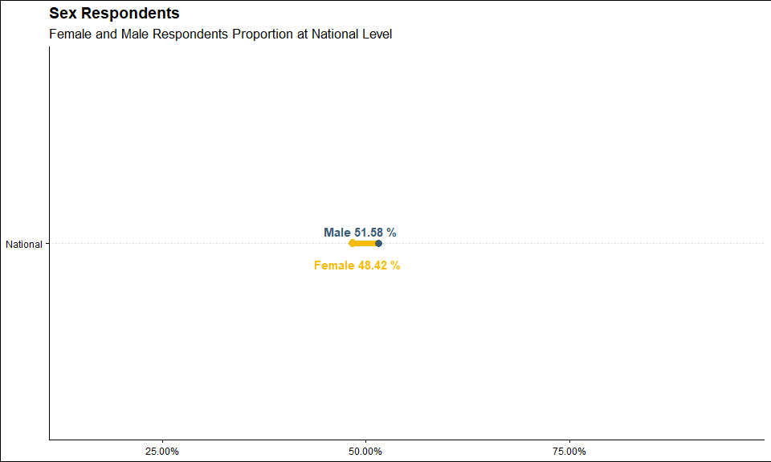
3
UNICEF – for every child

Slide 4
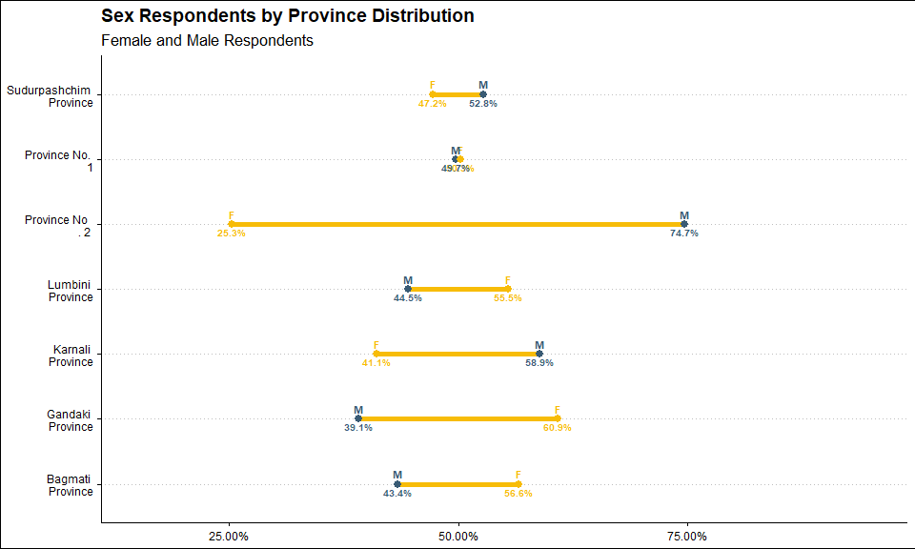
4
UNICEF – for every child

Slide 5
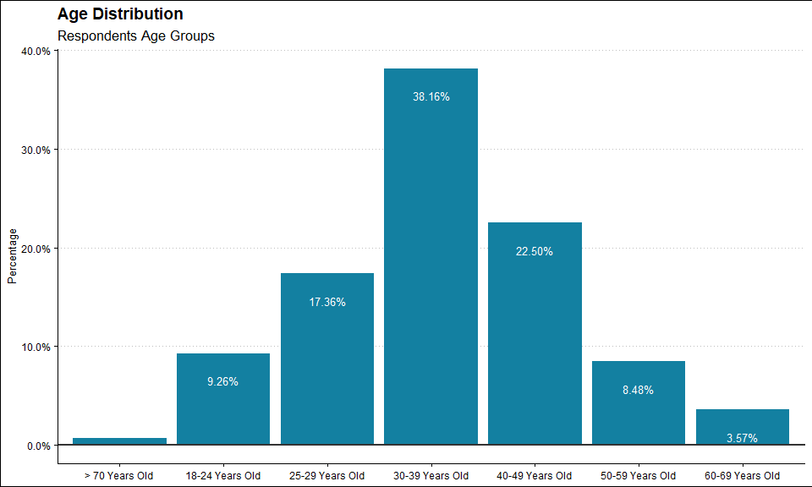
5
UNICEF – for every child

Slide 6
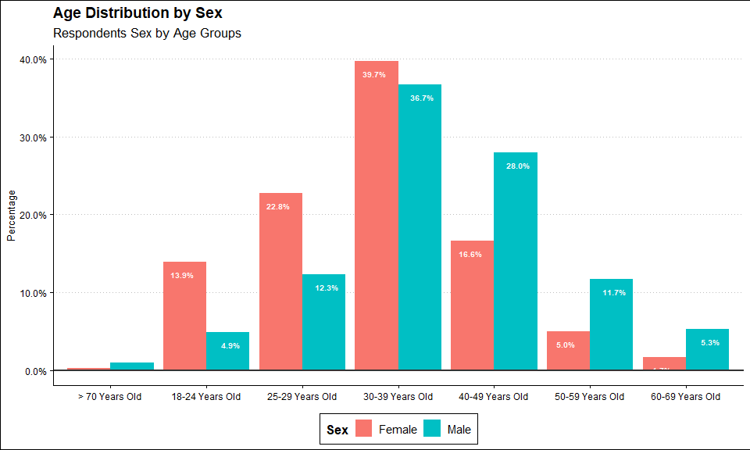
6
UNICEF – for every child

Slide 7
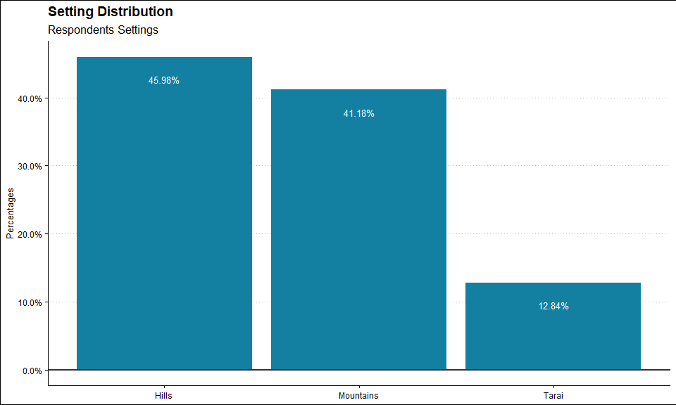
7
UNICEF – for every child

Slide 8
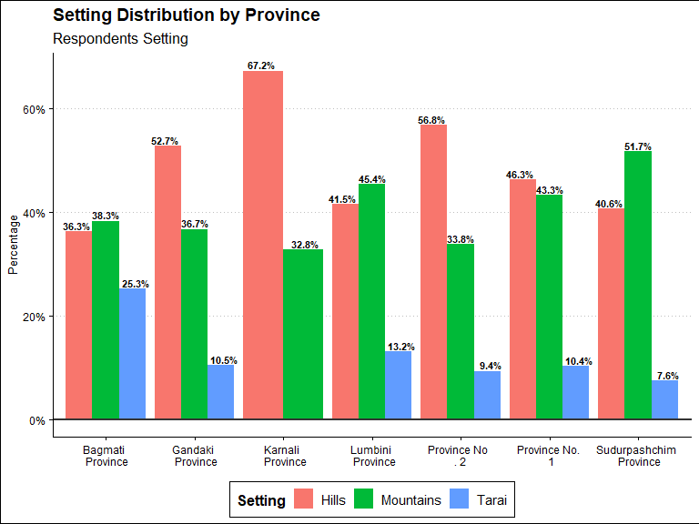
8
UNICEF – for every child

Slide 9
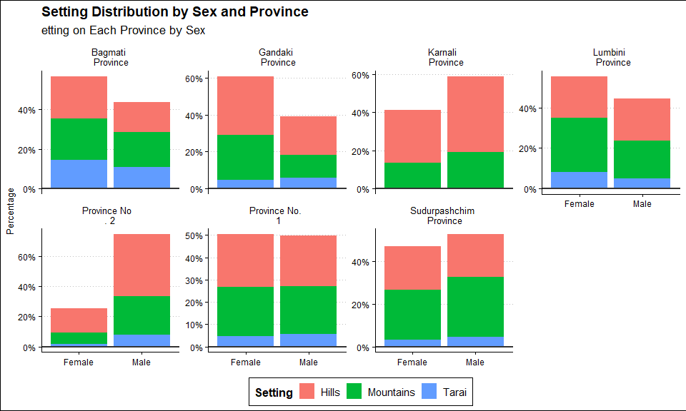
9
UNICEF – for every child

Slide 10
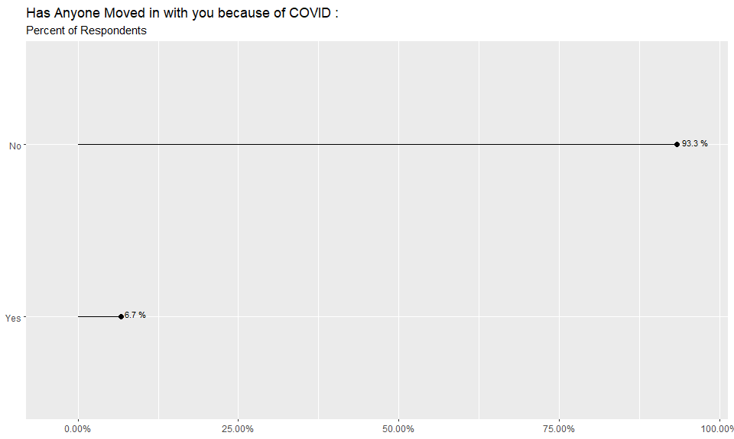
10
UNICEF – for every child

Slide 11
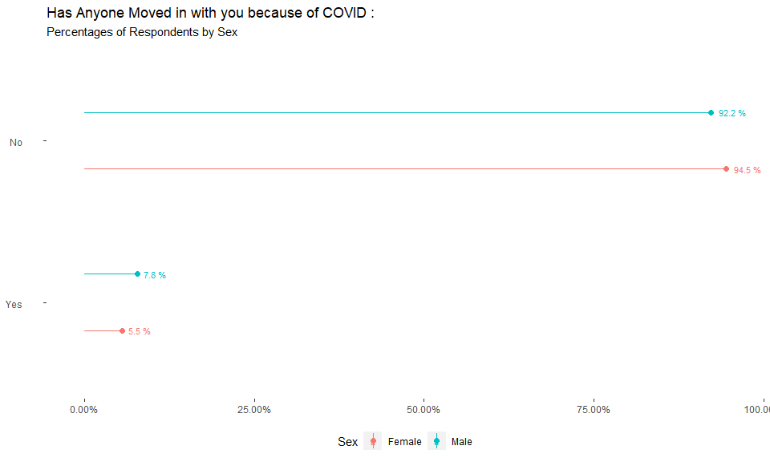
11
UNICEF – for every child

Slide 12
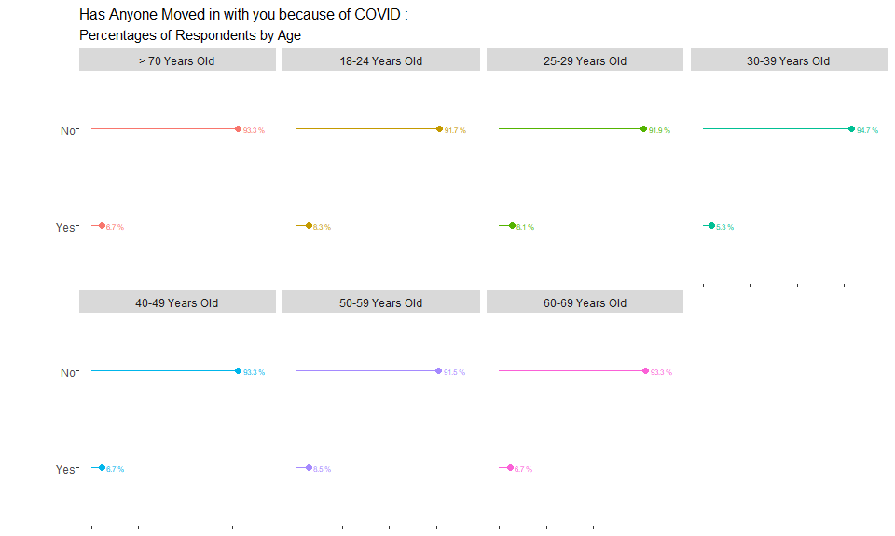
12
UNICEF – for every child

Slide 13
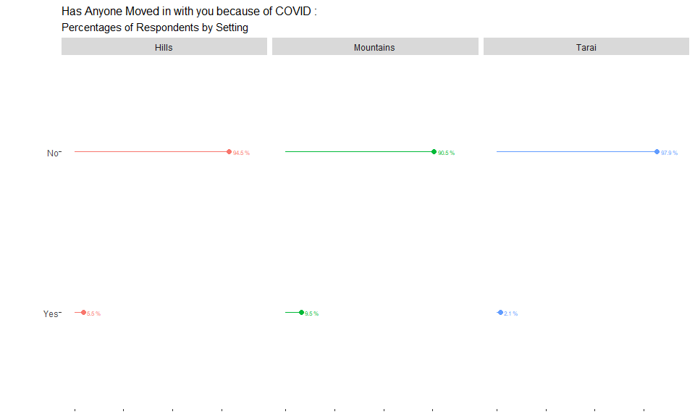
13
UNICEF – for every child

Slide 14
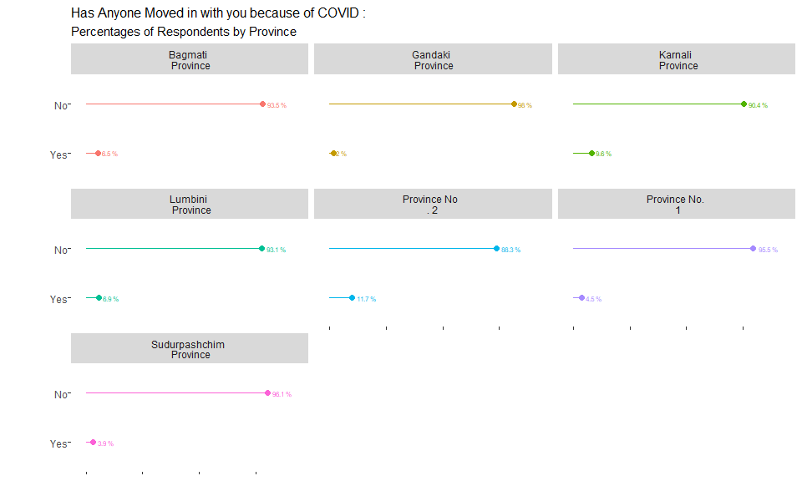
14
UNICEF – for every child

Slide 15
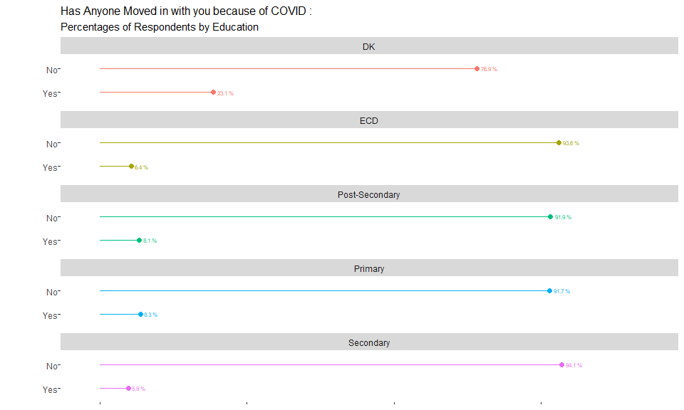
15
UNICEF – for every child

Slide 16
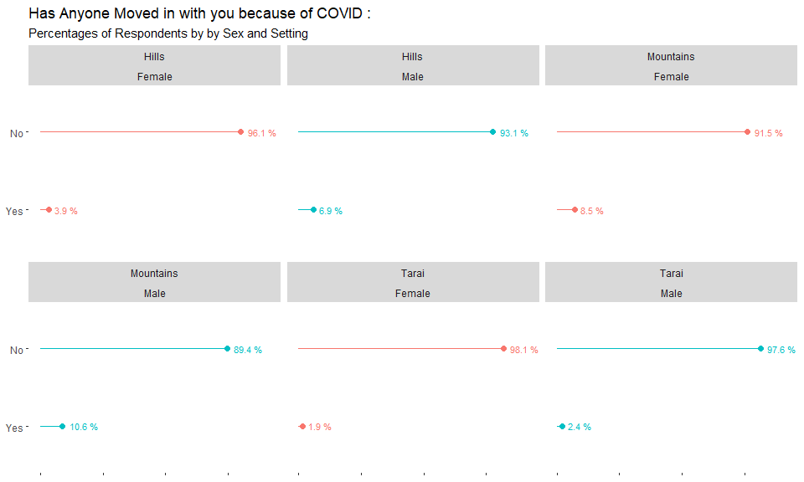
16
UNICEF – for every child

Slide 17
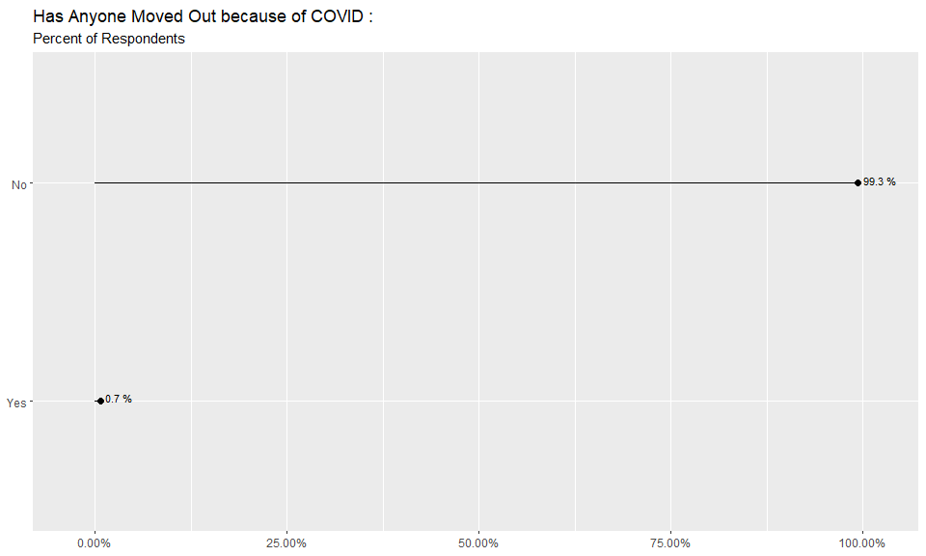
17
UNICEF – for every child

Slide 18
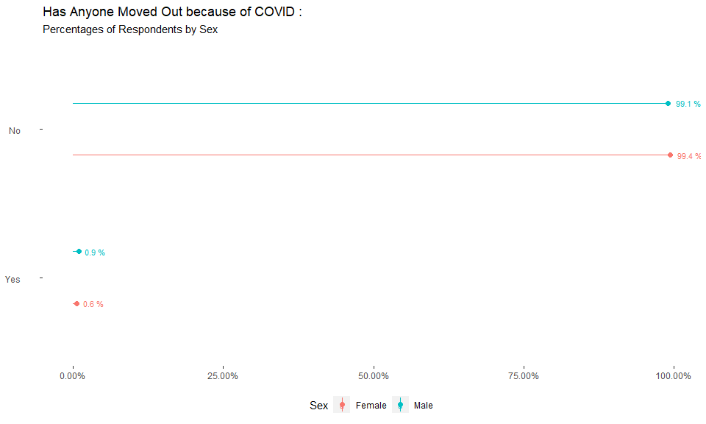
18
UNICEF – for every child

Slide 19
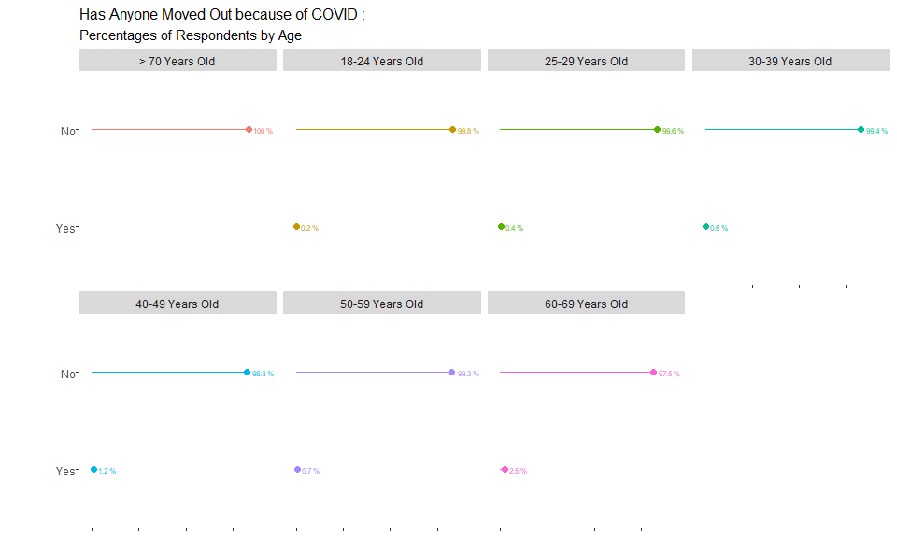
19
UNICEF – for every child

Slide 20
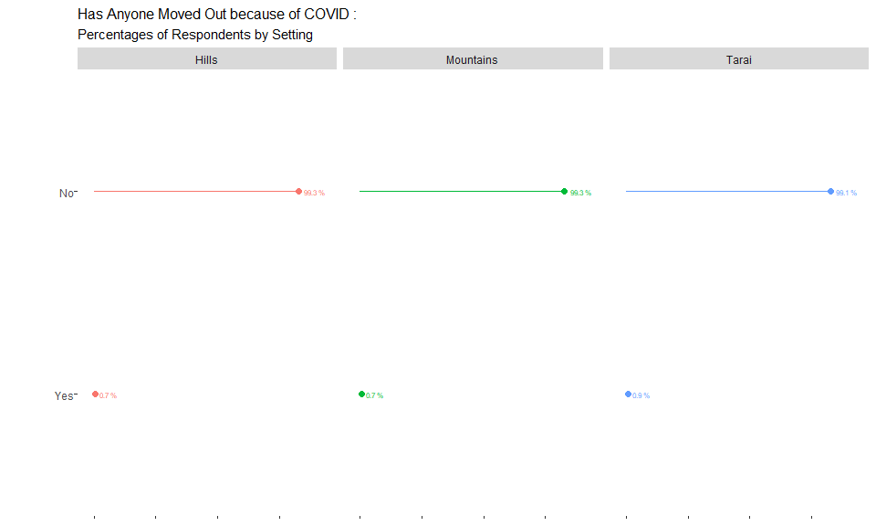
20
UNICEF – for every child

Slide 21
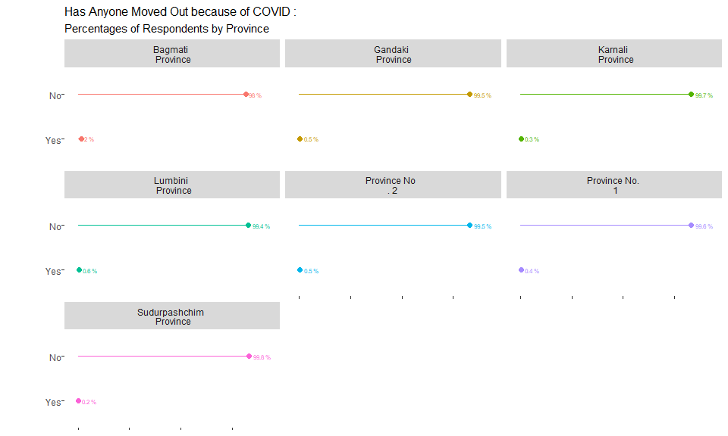
21
UNICEF – for every child

Slide 22
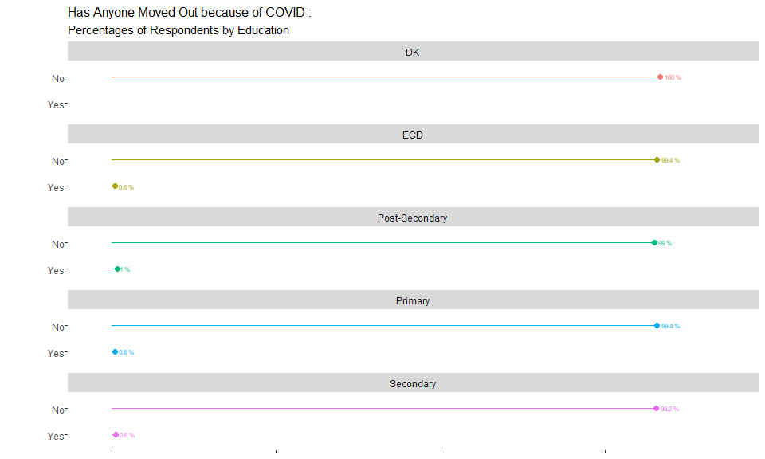
22
UNICEF – for every child

Slide 23
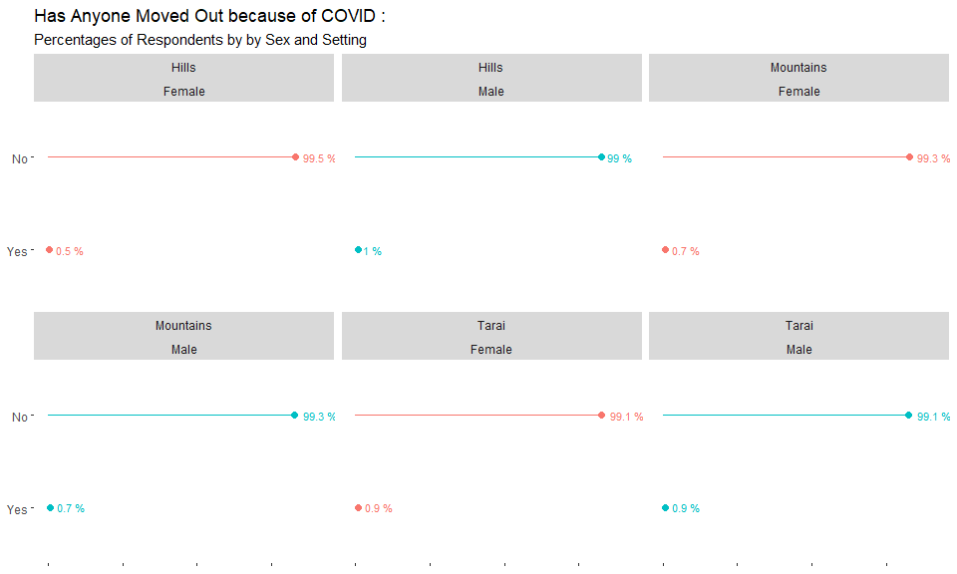
23
UNICEF – for every child

Slide 24
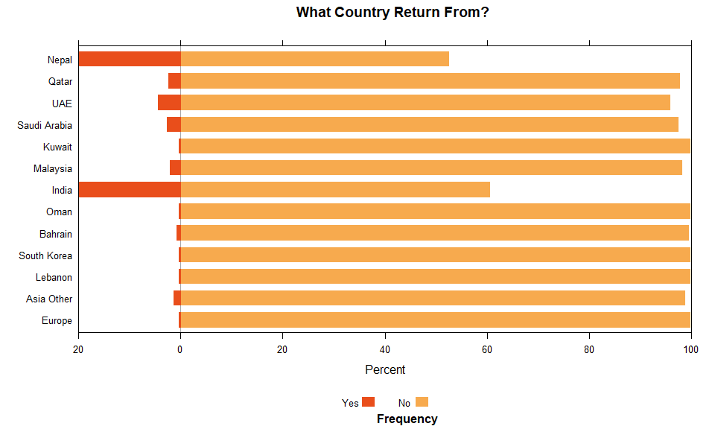
24
UNICEF – for every child

Slide 25
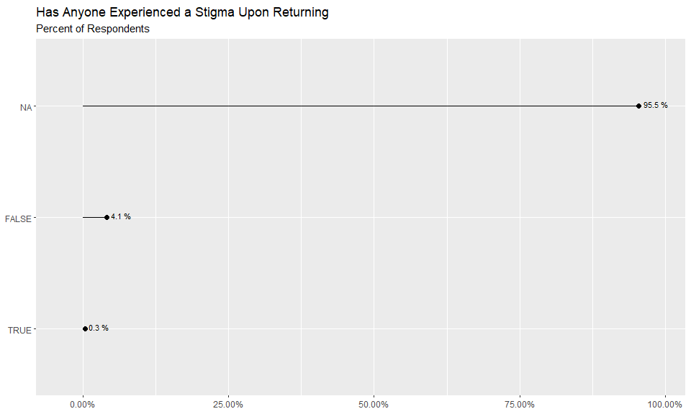
25
UNICEF – for every child

Slide 26
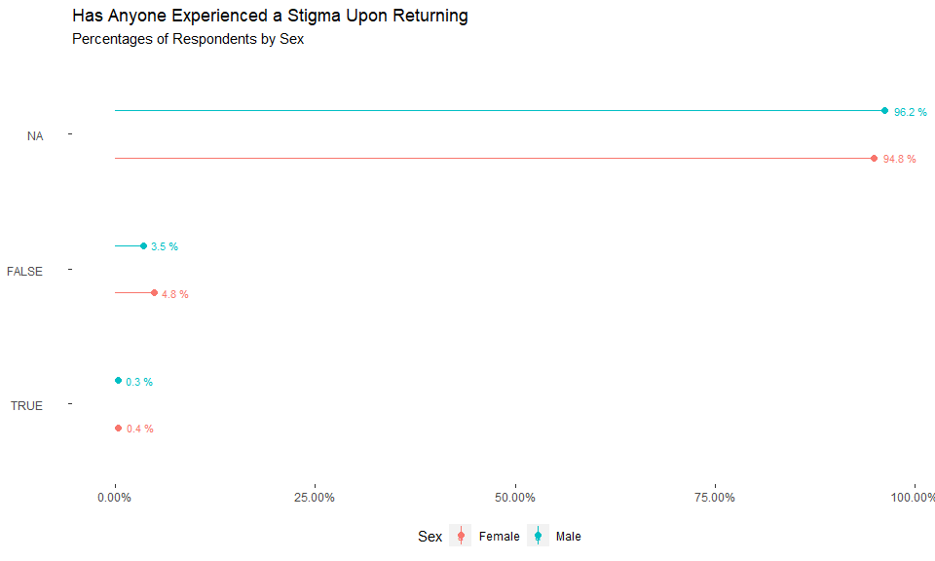
26
UNICEF – for every child

Slide 27
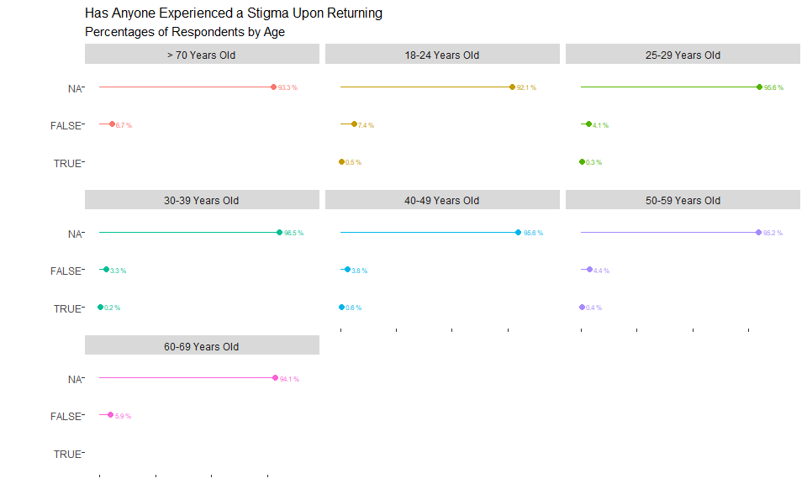
27
UNICEF – for every child

Slide 28
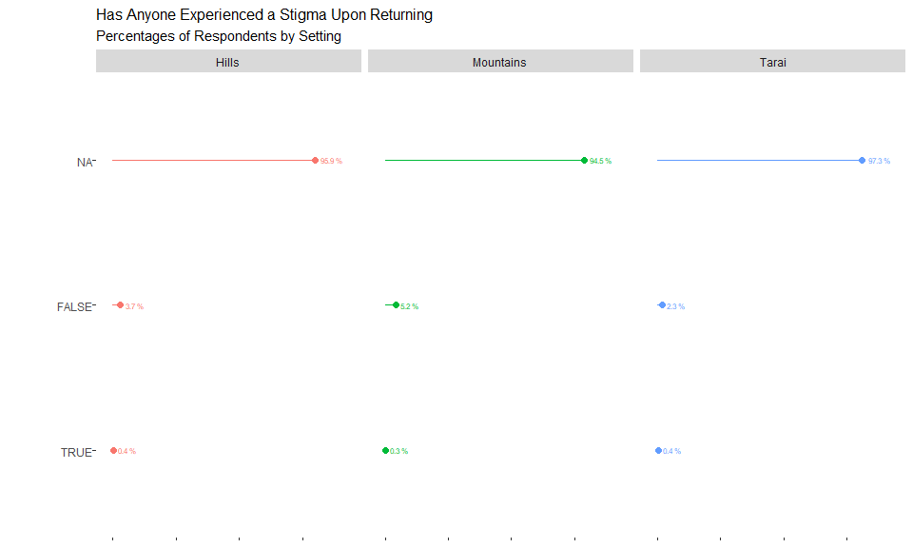
28
UNICEF – for every child

Slide 29

29
UNICEF – for every child

Slide 30
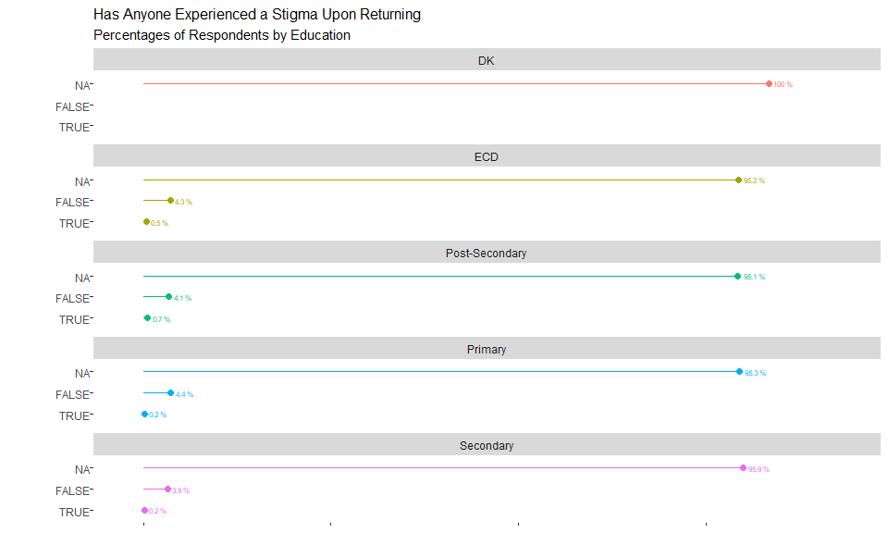
30
UNICEF – for every child

Slide 31
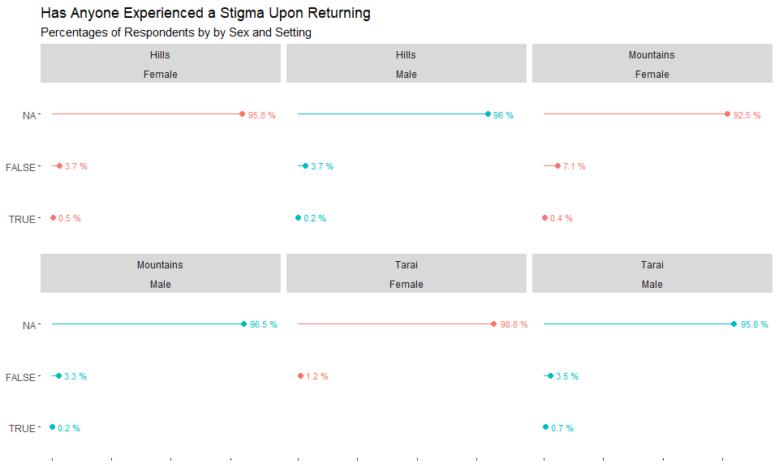
31
UNICEF – for every child

Slide 32
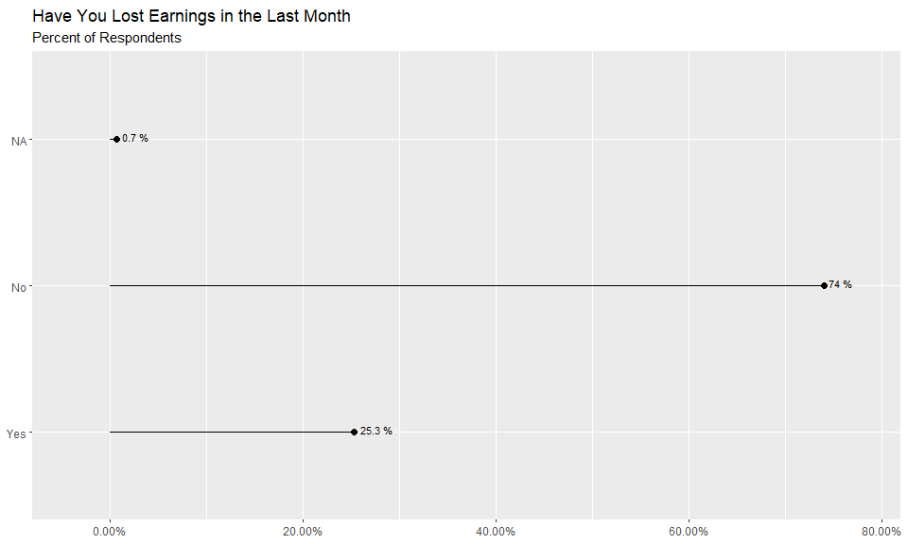
32
UNICEF – for every child

Slide 33
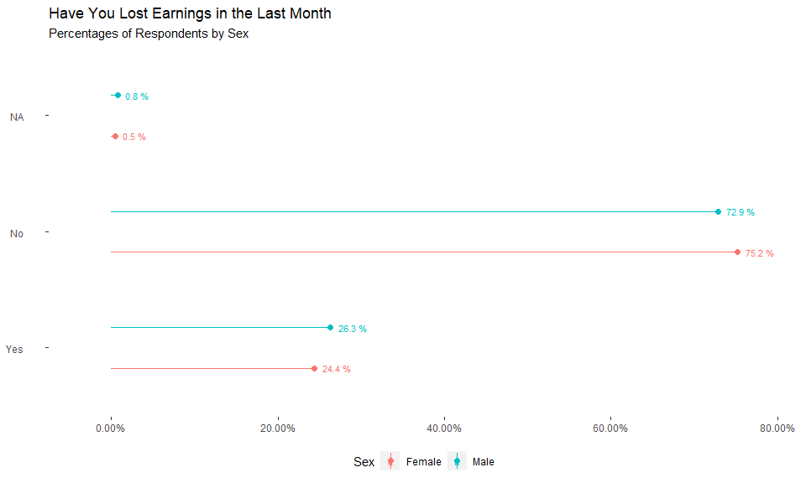
33
UNICEF – for every child

Slide 34
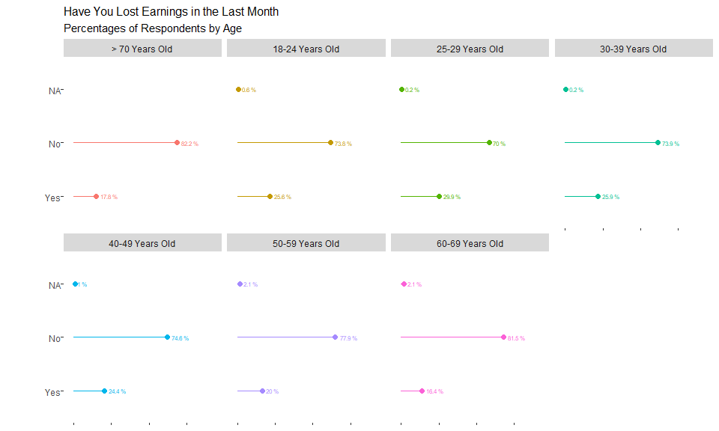
34
UNICEF – for every child

Slide 35
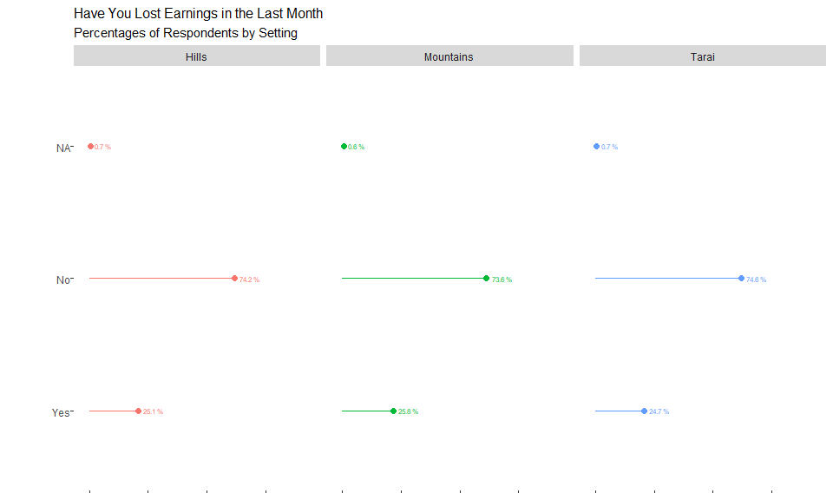
35
UNICEF – for every child

Slide 36
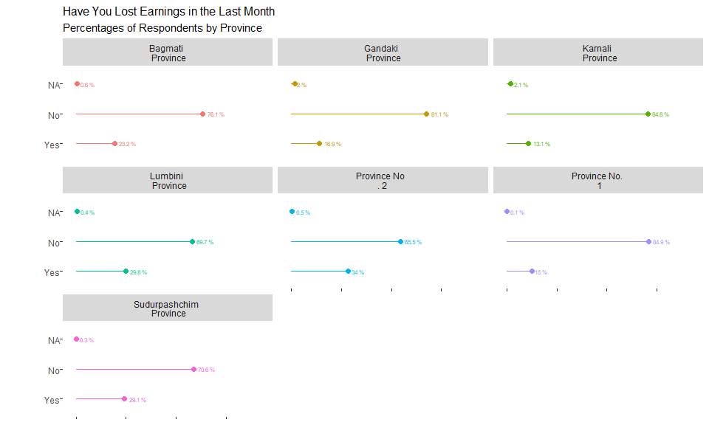
36
UNICEF – for every child

Slide 37
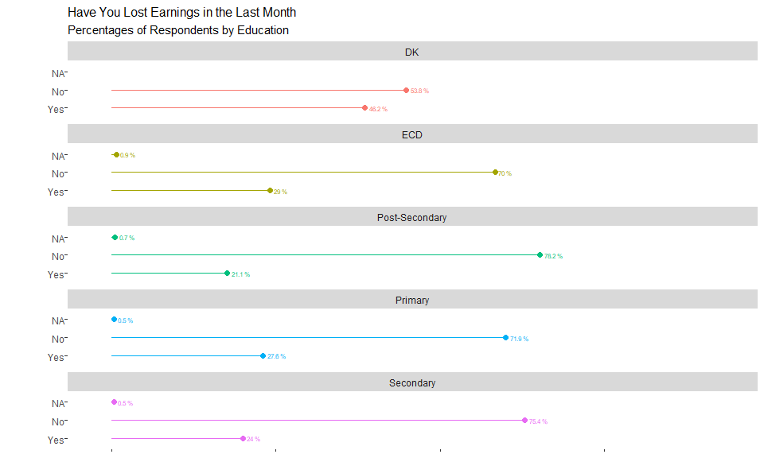
37
UNICEF – for every child

Slide 38
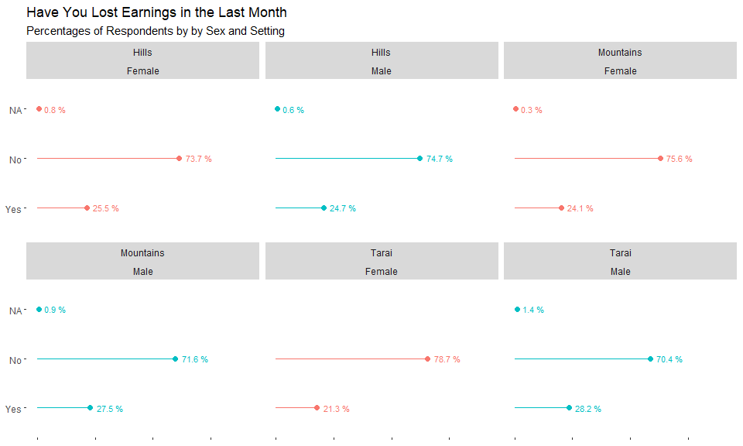
38
UNICEF – for every child

Slide 39
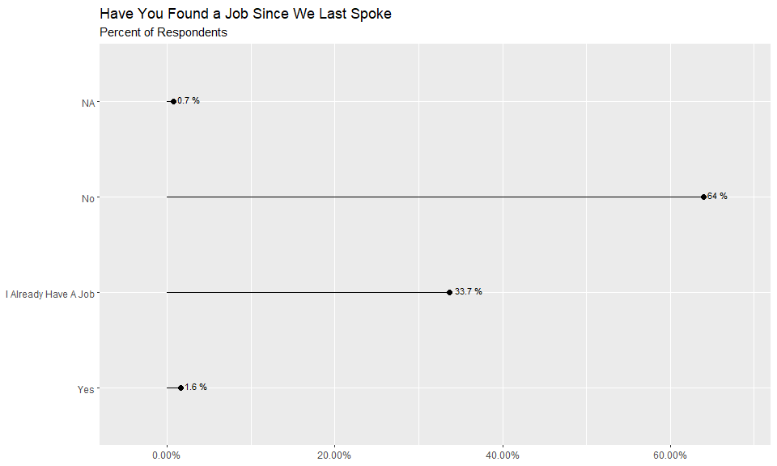
39
UNICEF – for every child

Slide 40
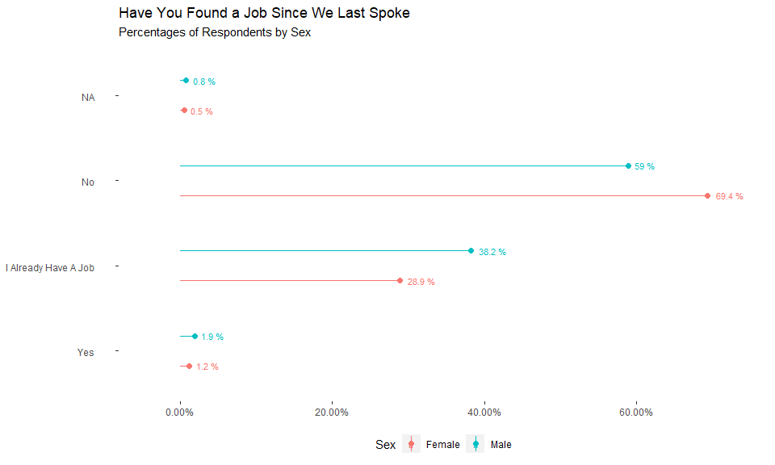
40
UNICEF – for every child

Slide 41
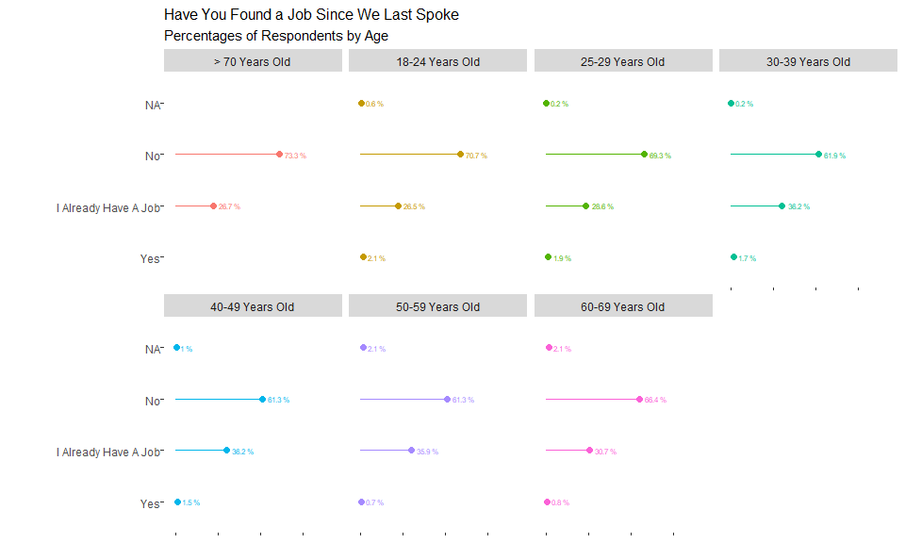
41
UNICEF – for every child

Slide 42
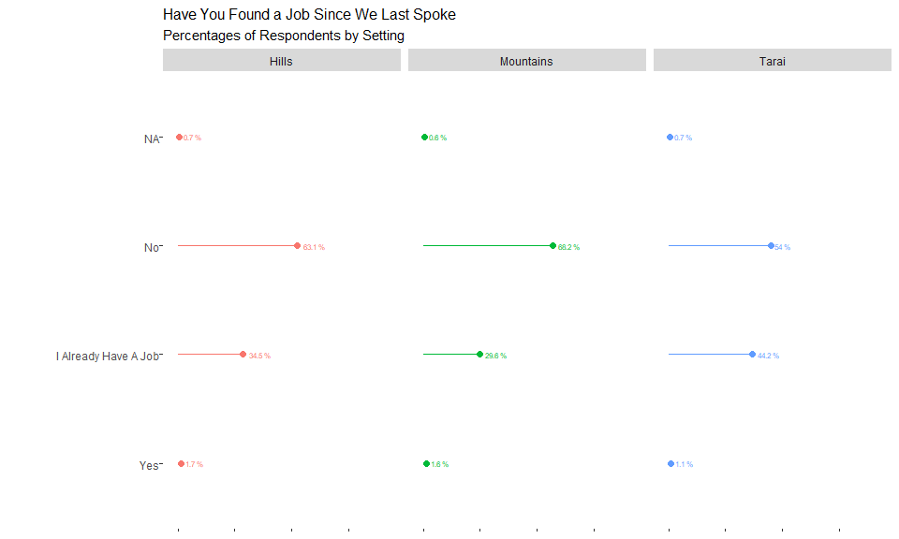
42
UNICEF – for every child

Slide 43
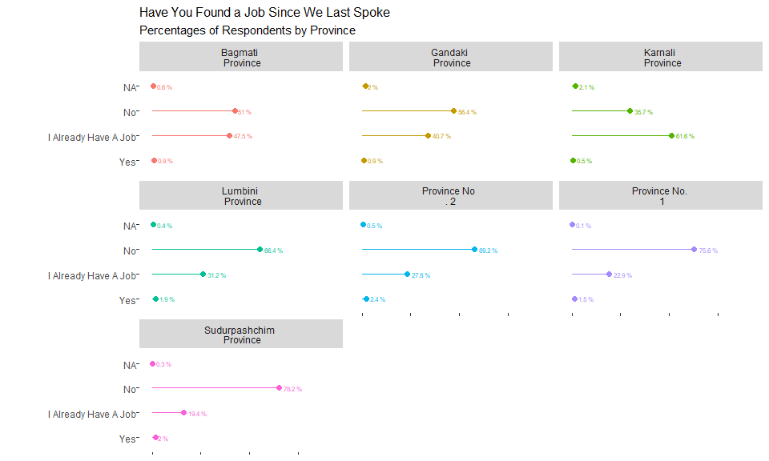
43
UNICEF – for every child

Slide 44
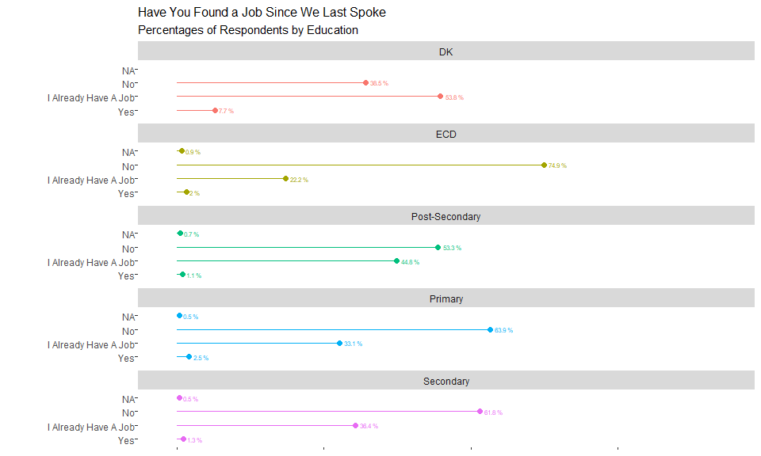
44
UNICEF – for every child

Slide 45
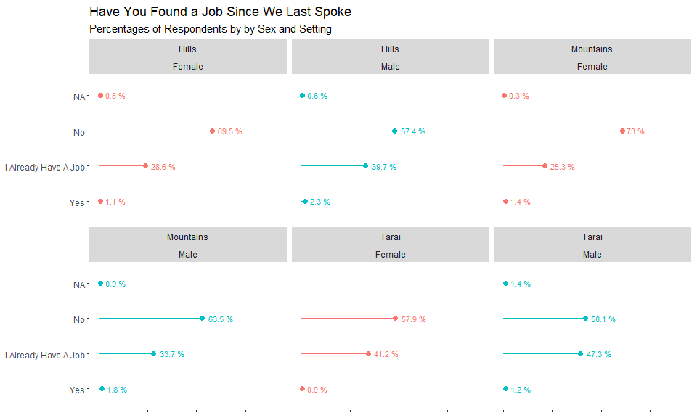
45
UNICEF – for every child

Slide 46
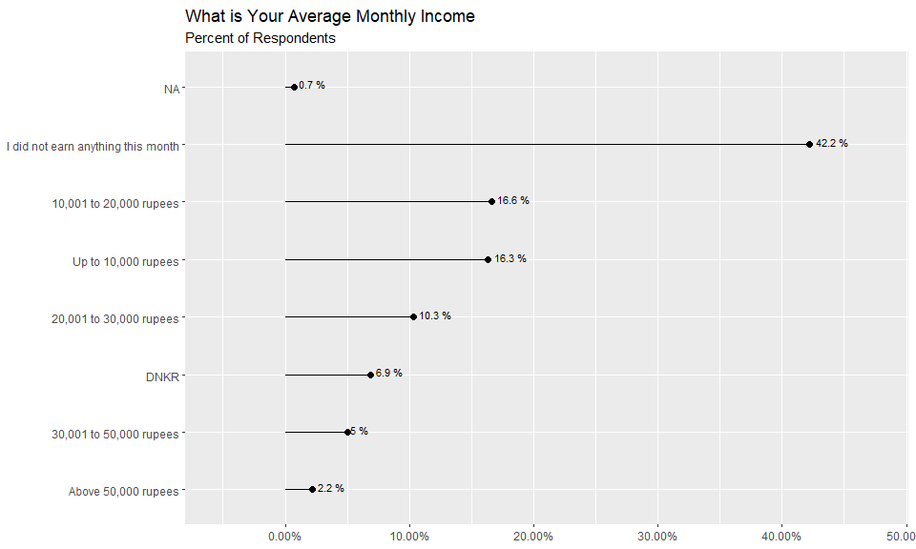
46
UNICEF – for every child

Slide 47
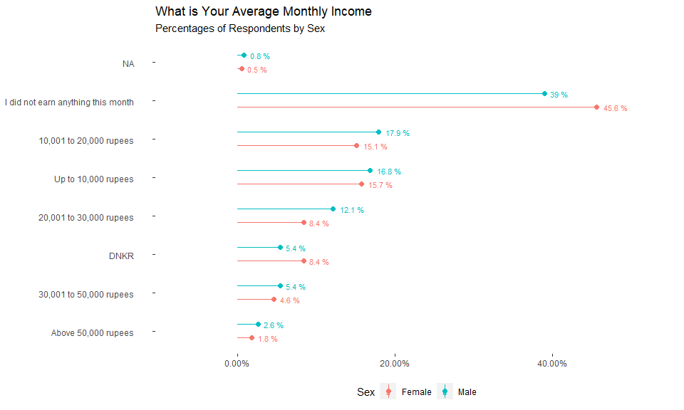
47
UNICEF – for every child

Slide 48
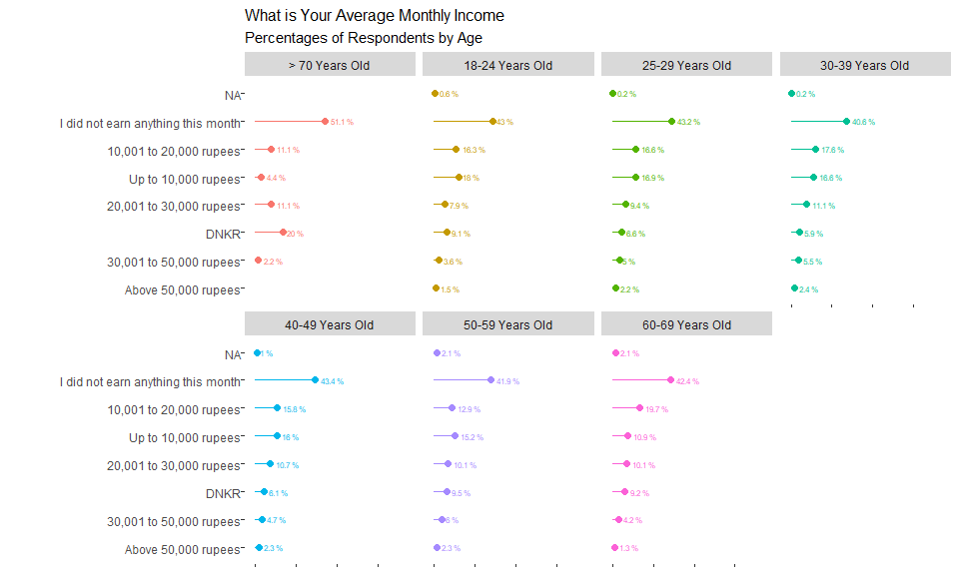
48
UNICEF – for every child

Slide 49
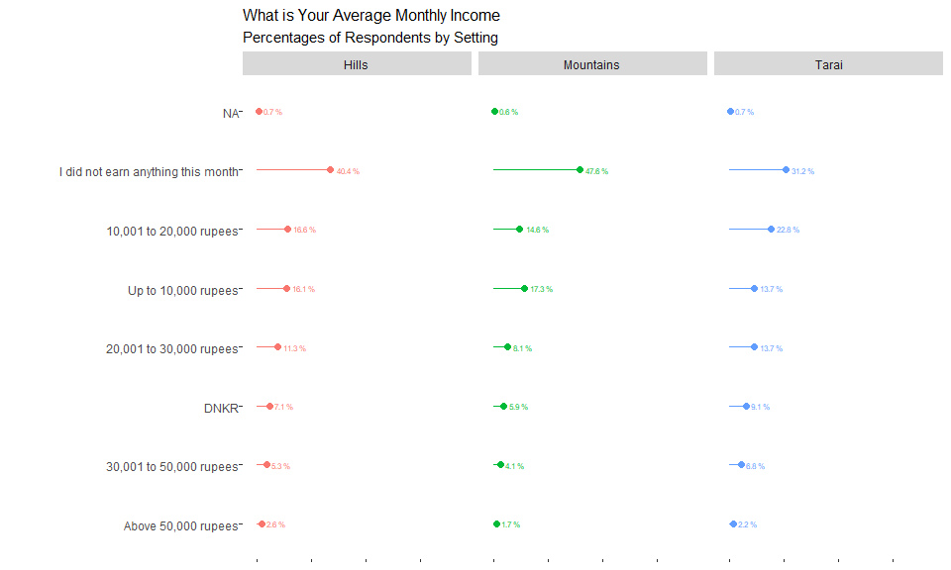
49
UNICEF – for every child

Slide 50
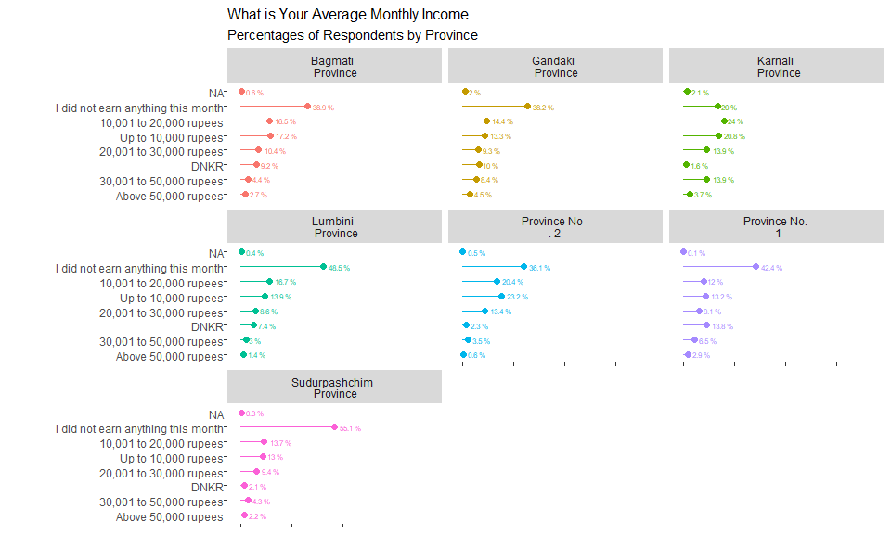
50
UNICEF – for every child

Slide 51
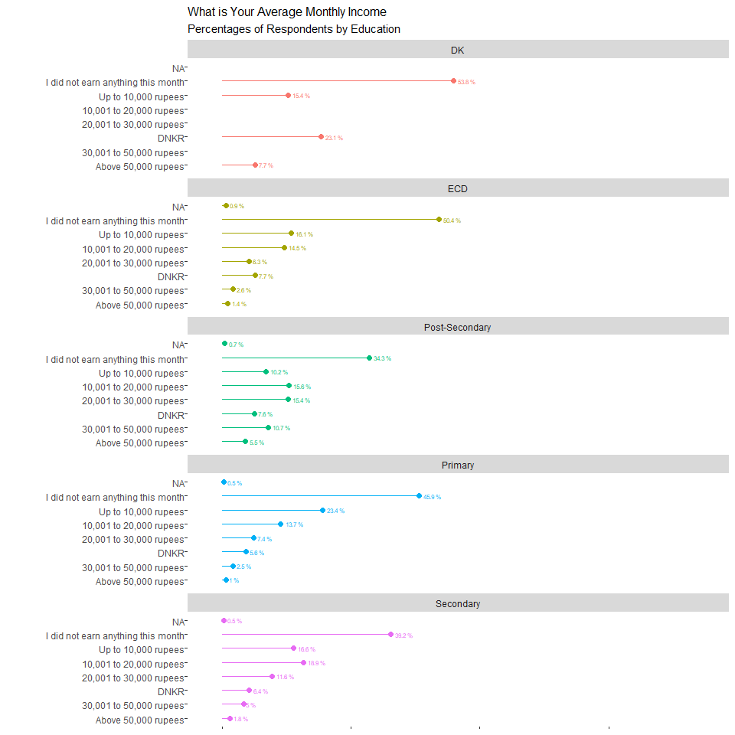
51
UNICEF – for every child

Slide 52
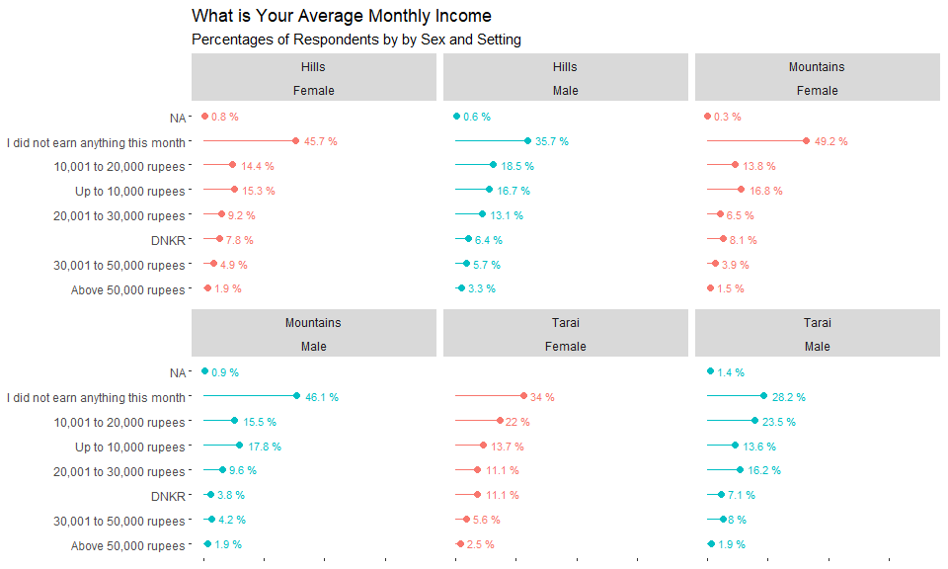
52
UNICEF – for every child

Slide 53

53
UNICEF – for every child

Slide 54

54
UNICEF – for every child

Slide 55

55
UNICEF – for every child

Slide 56

56
UNICEF – for every child

Slide 57

57
UNICEF – for every child

Slide 58

58
UNICEF – for every child

Slide 59

59
UNICEF – for every child

Slide 60

60
UNICEF – for every child

Slide 61

61
UNICEF – for every child

Slide 62

62
UNICEF – for every child

Slide 63

63
UNICEF – for every child

Slide 64

64
UNICEF – for every child

Slide 65

65
UNICEF – for every child

Slide 66

66
UNICEF – for every child

Slide 67

67
UNICEF – for every child

Slide 68

68
UNICEF – for every child

Slide 69

69
UNICEF – for every child

Slide 70

70
UNICEF – for every child

Slide 71

71
UNICEF – for every child

Slide 72

72
UNICEF – for every child

Slide 73

73
UNICEF – for every child

Slide 74

74
UNICEF – for every child

Slide 75

75
UNICEF – for every child

Slide 76

76
UNICEF – for every child

Slide 77

77
UNICEF – for every child

Slide 78

78
UNICEF – for every child

Slide 79

79
UNICEF – for every child

Slide 80

80
UNICEF – for every child

Slide 81

81
UNICEF – for every child

Slide 82

82
UNICEF – for every child

Slide 83

83
UNICEF – for every child

Slide 84

84
UNICEF – for every child

Slide 85

85
UNICEF – for every child

Slide 86

86
UNICEF – for every child

Slide 87

87
UNICEF – for every child

Slide 88

88
UNICEF – for every child

Slide 89

89
UNICEF – for every child

Slide 90

90
UNICEF – for every child

Slide 91

91
UNICEF – for every child

Slide 92

92
UNICEF – for every child

Slide 93

93
UNICEF – for every child

Slide 94

94
UNICEF – for every child

Slide 95

95
UNICEF – for every child

Slide 96

96
UNICEF – for every child

Slide 97

97
UNICEF – for every child

Slide 98

98
UNICEF – for every child

Slide 99

99
UNICEF – for every child

Slide 100

100
UNICEF – for every child

Slide 101

101
UNICEF – for every child

Slide 102

102
UNICEF – for every child

Slide 103

103
UNICEF – for every child

Slide 104

104
UNICEF – for every child

Slide 105

105
UNICEF – for every child

Slide 106

106
UNICEF – for every child

Slide 107

107
UNICEF – for every child

Slide 108

108
UNICEF – for every child

Slide 109

109
UNICEF – for every child

Slide 110

110
UNICEF – for every child

Slide 111

111
UNICEF – for every child

Slide 112

112
UNICEF – for every child

Slide 113

113
UNICEF – for every child

Slide 114

114
UNICEF – for every child

Slide 115

115
UNICEF – for every child

Slide 116

116
UNICEF – for every child

Slide 117

117
UNICEF – for every child

Slide 118

118
UNICEF – for every child

Slide 119

119
UNICEF – for every child

Slide 120

120
UNICEF – for every child

Slide 121

121
UNICEF – for every child

Slide 122

122
UNICEF – for every child

Slide 123

123
UNICEF – for every child

Slide 124

124
UNICEF – for every child

Slide 125

125
UNICEF – for every child

Slide 126

126
UNICEF – for every child

Slide 127

127
UNICEF – for every child

Slide 128

128
UNICEF – for every child

Slide 129

129
UNICEF – for every child

Slide 130

130
UNICEF – for every child

Slide 131

131
UNICEF – for every child

Slide 132

132
UNICEF – for every child

Slide 133

133
UNICEF – for every child

Slide 134

134
UNICEF – for every child

Slide 135

135
UNICEF – for every child

Slide 136

136
UNICEF – for every child

Slide 137

137
UNICEF – for every child

Slide 138

138
UNICEF – for every child

Slide 139

139
UNICEF – for every child

Slide 140

140
UNICEF – for every child

Slide 141

141
UNICEF – for every child

Slide 142

142
UNICEF – for every child

Slide 143

143
UNICEF – for every child

Slide 144

144
UNICEF – for every child

Slide 145

145
UNICEF – for every child

Slide 146

146
UNICEF – for every child

Slide 147

147
UNICEF – for every child

Slide 148

148
UNICEF – for every child

Slide 149

149
UNICEF – for every child

Slide 150

150
UNICEF – for every child

Slide 151

151
UNICEF – for every child

Slide 152

152
UNICEF – for every child

Slide 153

153
UNICEF – for every child

Slide 154

154
UNICEF – for every child

Slide 155

155
UNICEF – for every child

Slide 156

156
UNICEF – for every child

Slide 157

157
UNICEF – for every child

Slide 158

158
UNICEF – for every child

Slide 159

159
UNICEF – for every child

Slide 160

160
UNICEF – for every child

Slide 161

161
UNICEF – for every child

Slide 162

162
UNICEF – for every child

Slide 163

163
UNICEF – for every child

Slide 164

164
UNICEF – for every child

Slide 165

165
UNICEF – for every child

Slide 166

166
UNICEF – for every child

Slide 167

167
UNICEF – for every child

Slide 168

168
UNICEF – for every child

Slide 169

169
UNICEF – for every child

Slide 170

170
UNICEF – for every child

Slide 171

171
UNICEF – for every child

Slide 172

172
UNICEF – for every child

Slide 173

173
UNICEF – for every child

Slide 174

174
UNICEF – for every child

Slide 175

175
UNICEF – for every child

Slide 176

176
UNICEF – for every child

Slide 177

177
UNICEF – for every child

Slide 178

178
UNICEF – for every child

Slide 179

179
UNICEF – for every child

Slide 180

180
UNICEF – for every child

Slide 181

181
UNICEF – for every child

Slide 182

182
UNICEF – for every child

Slide 183

183
UNICEF – for every child

Slide 184

184
UNICEF – for every child

Slide 185

185
UNICEF – for every child

Slide 186

186
UNICEF – for every child

Slide 187

187
UNICEF – for every child

Slide 188

188
UNICEF – for every child

Slide 189

189
UNICEF – for every child

Slide 190

190
UNICEF – for every child

Slide 191

191
UNICEF – for every child

Slide 192

192
UNICEF – for every child

Slide 193

193
UNICEF – for every child

Slide 194

194
UNICEF – for every child

Slide 195

195
UNICEF – for every child

Slide 196

196
UNICEF – for every child

Slide 197

197
UNICEF – for every child

Slide 198

198
UNICEF – for every child

Slide 199

199
UNICEF – for every child

Slide 200

200
UNICEF – for every child

Slide 201

201
UNICEF – for every child

Slide 202

202
UNICEF – for every child

Slide 203

203
UNICEF – for every child

Slide 204

204
UNICEF – for every child

Slide 205

205
UNICEF – for every child

Slide 206

206
UNICEF – for every child

Slide 207

207
UNICEF – for every child

Slide 208

208
UNICEF – for every child

Slide 209

209
UNICEF – for every child

Slide 210

210
UNICEF – for every child

Slide 211

211
UNICEF – for every child

Slide 212

212
UNICEF – for every child

Slide 213

213
UNICEF – for every child

Slide 214

214
UNICEF – for every child

Slide 215

215
UNICEF – for every child

Slide 216

216
UNICEF – for every child

Slide 217

217
UNICEF – for every child

Slide 218

218
UNICEF – for every child

Slide 219

219
UNICEF – for every child

Slide 220

220
UNICEF – for every child

Slide 221

221
UNICEF – for every child

Slide 222

222
UNICEF – for every child

Slide 223

223
UNICEF – for every child

Slide 224

224
UNICEF – for every child

Slide 225

225
UNICEF – for every child

Slide 226

226
UNICEF – for every child

Slide 227

227
UNICEF – for every child

Slide 228

228
UNICEF – for every child

Slide 229

229
UNICEF – for every child

Slide 230

230
UNICEF – for every child

Slide 231

231
UNICEF – for every child

Slide 232

232
UNICEF – for every child

Slide 233

233
UNICEF – for every child

Slide 234

234
UNICEF – for every child

Slide 235

235
UNICEF – for every child

Slide 236

236
UNICEF – for every child

Slide 237

237
UNICEF – for every child

Slide 238

238
UNICEF – for every child

Slide 239

239
UNICEF – for every child

Slide 240

240
UNICEF – for every child

Slide 241

241
UNICEF – for every child

Slide 242

242
UNICEF – for every child

Slide 243

243
UNICEF – for every child

Slide 244

244
UNICEF – for every child

Slide 245

245
UNICEF – for every child

Slide 246

246
UNICEF – for every child

Slide 247

247
UNICEF – for every child

Slide 248

248
UNICEF – for every child

Slide 249

249
UNICEF – for every child

Slide 250

250
UNICEF – for every child

Slide 251

251
UNICEF – for every child

Slide 252

252
UNICEF – for every child

Slide 253

253
UNICEF – for every child

Slide 254

254
UNICEF – for every child

Slide 255

255
UNICEF – for every child

Slide 256

256
UNICEF – for every child

Slide 257

257
UNICEF – for every child

Slide 258

258
UNICEF – for every child

Slide 259

259
UNICEF – for every child

Slide 260

260
UNICEF – for every child

Slide 261

261
UNICEF – for every child

Slide 262

262
UNICEF – for every child

Slide 263

263
UNICEF – for every child

Slide 264

264
UNICEF – for every child

Slide 265

265
UNICEF – for every child

Slide 266

266
UNICEF – for every child

Slide 267

267
UNICEF – for every child

Slide 268

268
UNICEF – for every child

Slide 269

269
UNICEF – for every child

Slide 270

270
UNICEF – for every child

Slide 271

271
UNICEF – for every child

Slide 272

272
UNICEF – for every child

Slide 273

273
UNICEF – for every child

Slide 274

274
UNICEF – for every child

Slide 275

275
UNICEF – for every child

Slide 276

276
UNICEF – for every child

Slide 277

277
UNICEF – for every child

Slide 278

278
UNICEF – for every child

Slide 279

279
UNICEF – for every child

Slide 280

280
UNICEF – for every child

Slide 281

281
UNICEF – for every child

Slide 282

282
UNICEF – for every child

Slide 283

283
UNICEF – for every child

Slide 284

284
UNICEF – for every child

Slide 285

285
UNICEF – for every child

Slide 286

286
UNICEF – for every child

Slide 287

287
UNICEF – for every child

Slide 288

288
UNICEF – for every child

Slide 289

289
UNICEF – for every child

Slide 290

290
UNICEF – for every child

Slide 291

291
UNICEF – for every child

Slide 292

292
UNICEF – for every child

Slide 293

293
UNICEF – for every child

Slide 294

294
UNICEF – for every child

Slide 295

295
UNICEF – for every child

Slide 296

296
UNICEF – for every child

Slide 297

297
UNICEF – for every child

Slide 298

298
UNICEF – for every child

Slide 299

299
UNICEF – for every child

Slide 300

300
UNICEF – for every child

Slide 301

301
UNICEF – for every child

Slide 302

302
UNICEF – for every child

Slide 303

303
UNICEF – for every child

Slide 304

304
UNICEF – for every child

Slide 305

305
UNICEF – for every child

Slide 306

306
UNICEF – for every child

Slide 307

307
UNICEF – for every child

Slide 308

308
UNICEF – for every child

Slide 309

309
UNICEF – for every child

Slide 310

310
UNICEF – for every child

Slide 311

311
UNICEF – for every child

Slide 312

312
UNICEF – for every child

Slide 313

313
UNICEF – for every child

Slide 314

314
UNICEF – for every child

Slide 315

315
UNICEF – for every child

Slide 316

316
UNICEF – for every child

Slide 317

317
UNICEF – for every child

Slide 318

318
UNICEF – for every child

Slide 319

319
UNICEF – for every child

Slide 320

320
UNICEF – for every child

Slide 321

321
UNICEF – for every child

Slide 322

322
UNICEF – for every child

Slide 323

323
UNICEF – for every child

Slide 324

324
UNICEF – for every child

Slide 325

325
UNICEF – for every child

Slide 326

326
UNICEF – for every child

Slide 327

327
UNICEF – for every child

Slide 328

328
UNICEF – for every child

Slide 329

329
UNICEF – for every child

Slide 330

330
UNICEF – for every child

Slide 331

331
UNICEF – for every child

Slide 332

332
UNICEF – for every child

Slide 333

333
UNICEF – for every child

Slide 334

334
UNICEF – for every child

Slide 335

335
UNICEF – for every child

Slide 336

336
UNICEF – for every child

Slide 337

337
UNICEF – for every child

Slide 338

338
UNICEF – for every child

Slide 339

339
UNICEF – for every child

Slide 340

340
UNICEF – for every child

Slide 341

341
UNICEF – for every child

Slide 342

342
UNICEF – for every child

Slide 343

343
UNICEF – for every child

Slide 344

344
UNICEF – for every child

Slide 345

345
UNICEF – for every child

Slide 346

346
UNICEF – for every child

Slide 347

347
UNICEF – for every child

Slide 348

348
UNICEF – for every child

Slide 349

349
UNICEF – for every child

Slide 350

350
UNICEF – for every child

Slide 351

351
UNICEF – for every child

Slide 352

352
UNICEF – for every child

Slide 353

353
UNICEF – for every child

Slide 354

354
UNICEF – for every child

Slide 355

355
UNICEF – for every child

Slide 356

356
UNICEF – for every child

Slide 357

357
UNICEF – for every child

Slide 358

358
UNICEF – for every child

Slide 359

359
UNICEF – for every child

